Slide 1
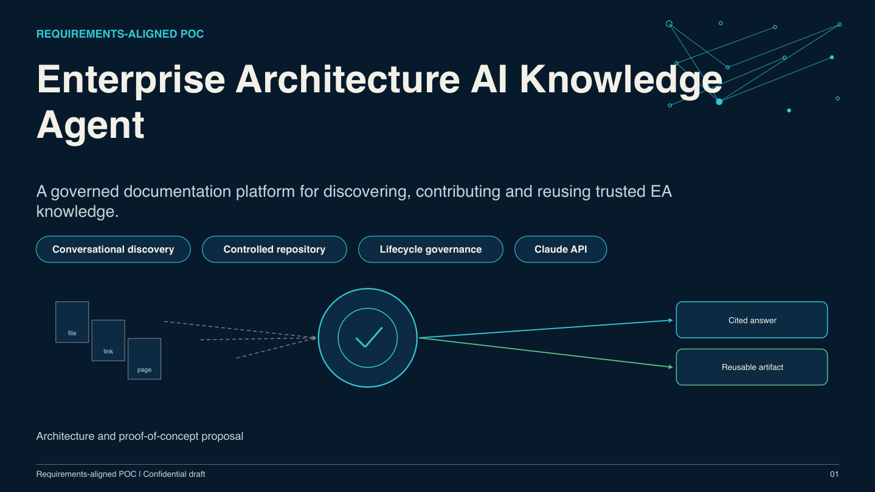

Slide 2
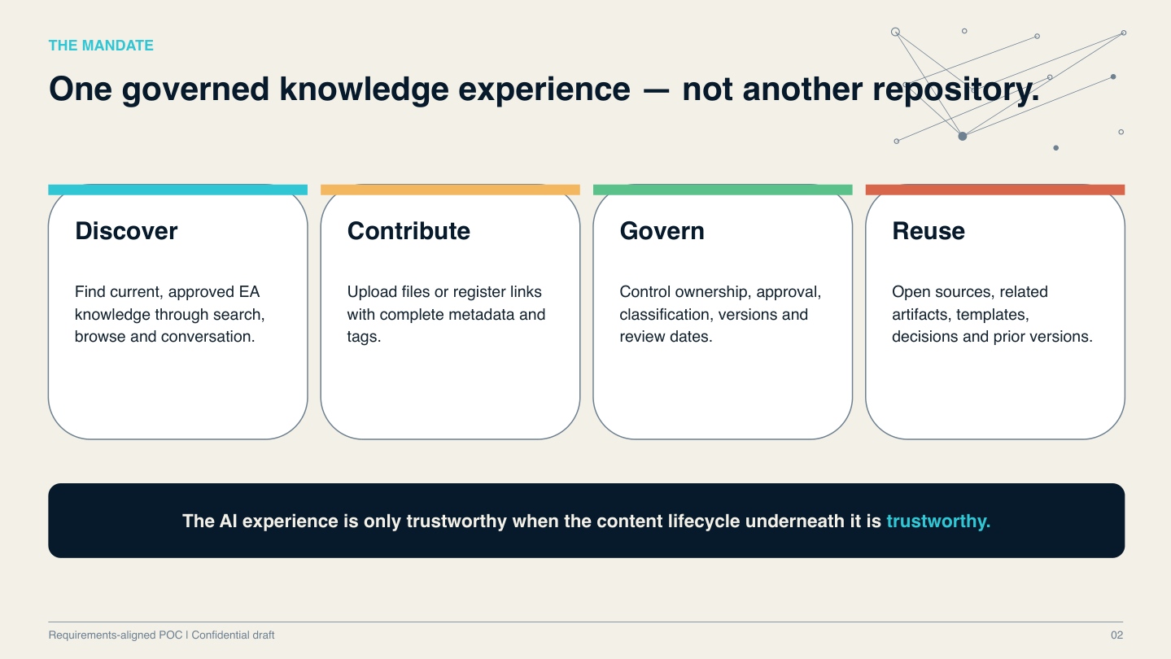

Slide 3
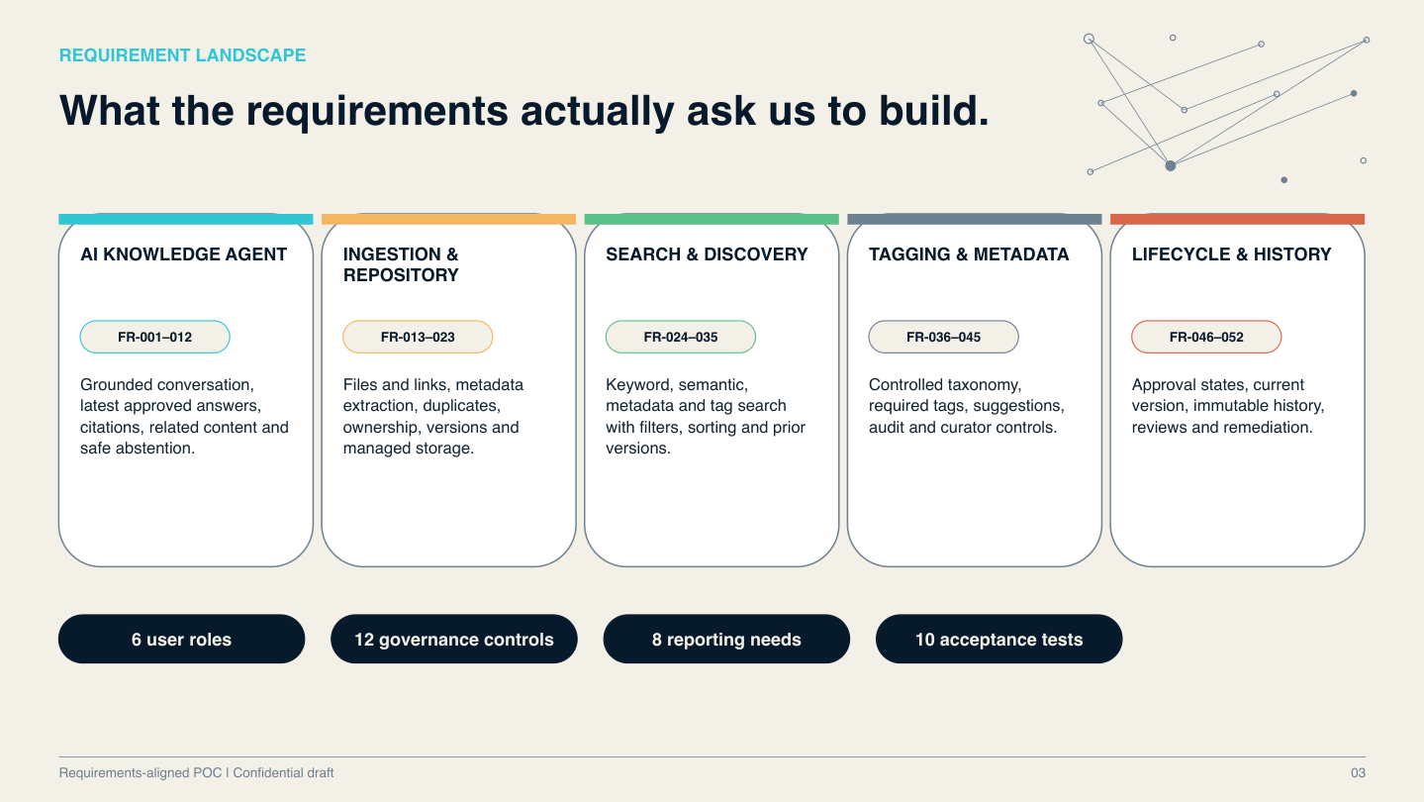

Slide 4
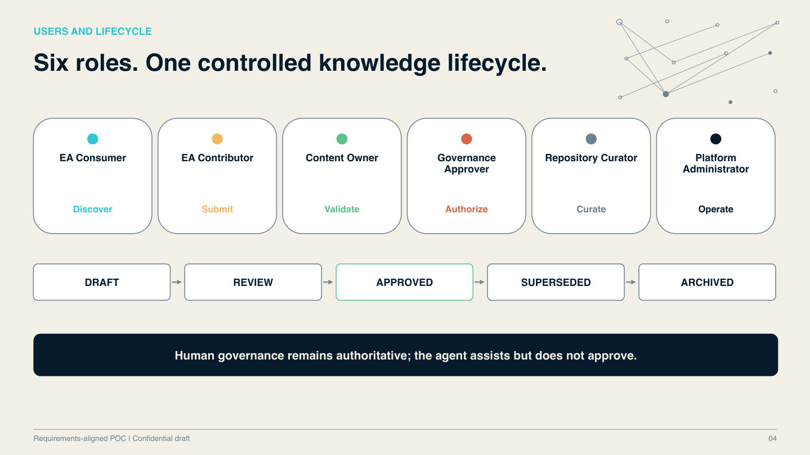

Slide 5
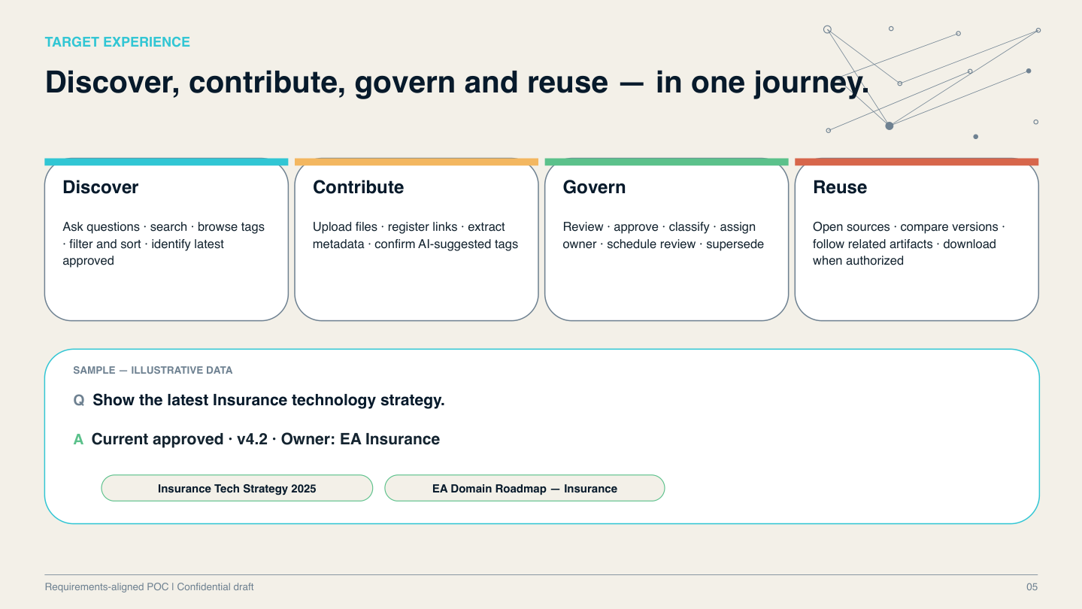

Slide 6
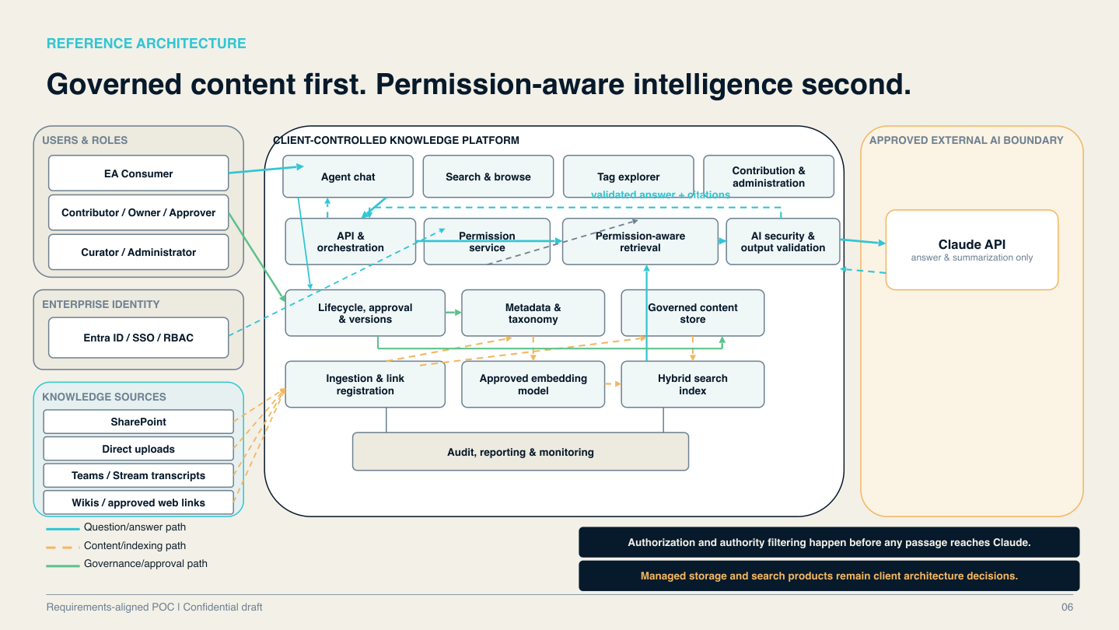

Slide 7
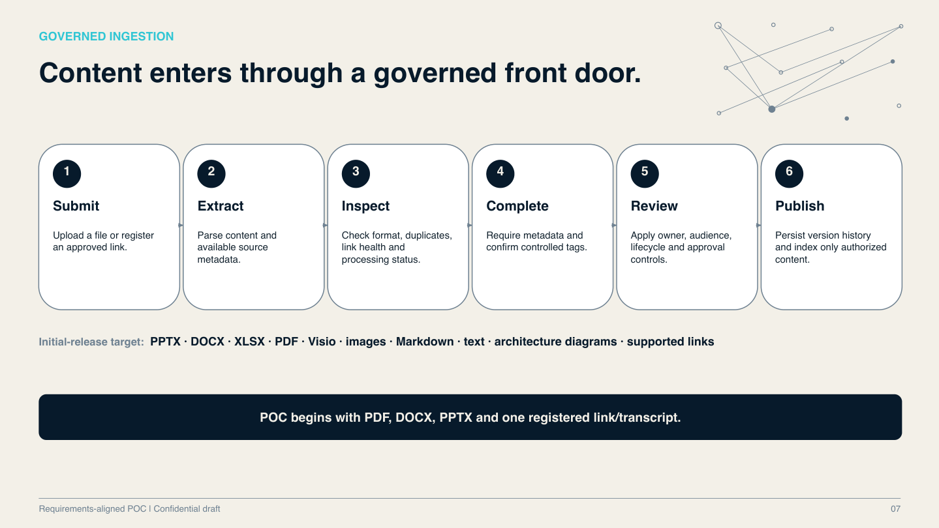

Slide 8
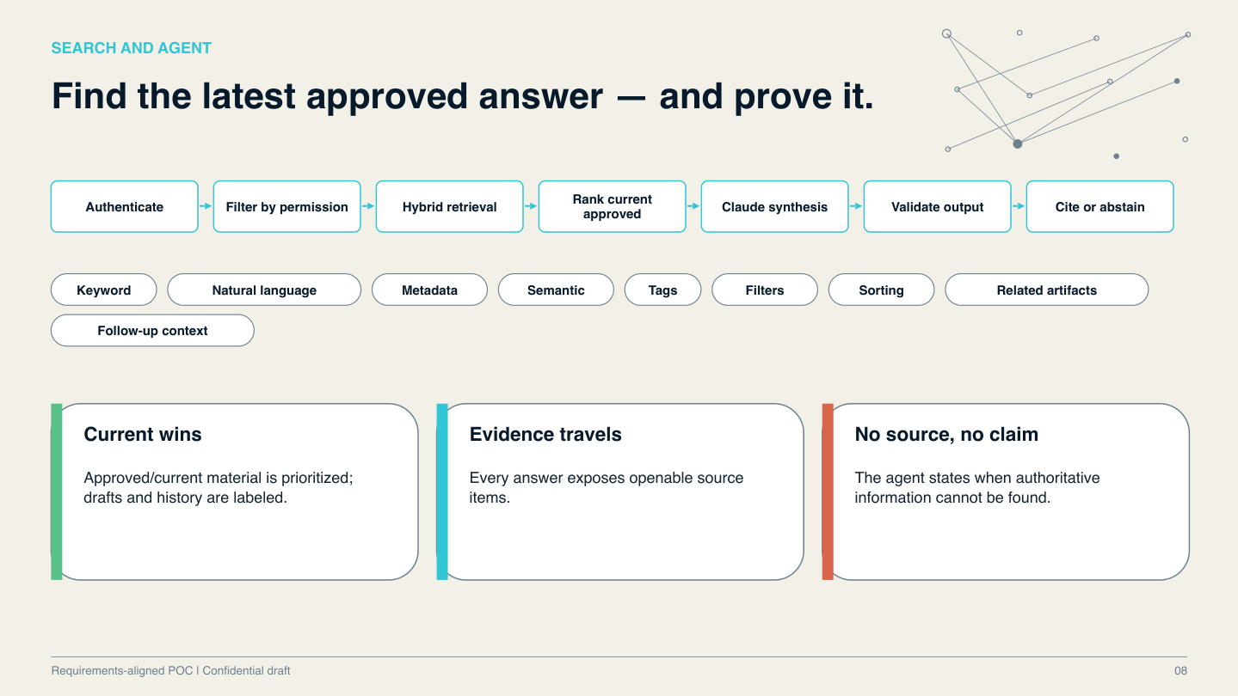

Slide 9
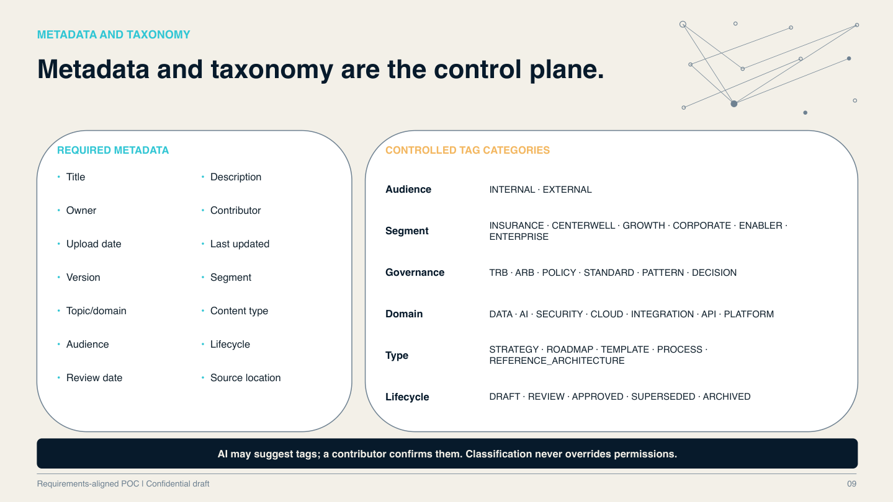

Slide 10
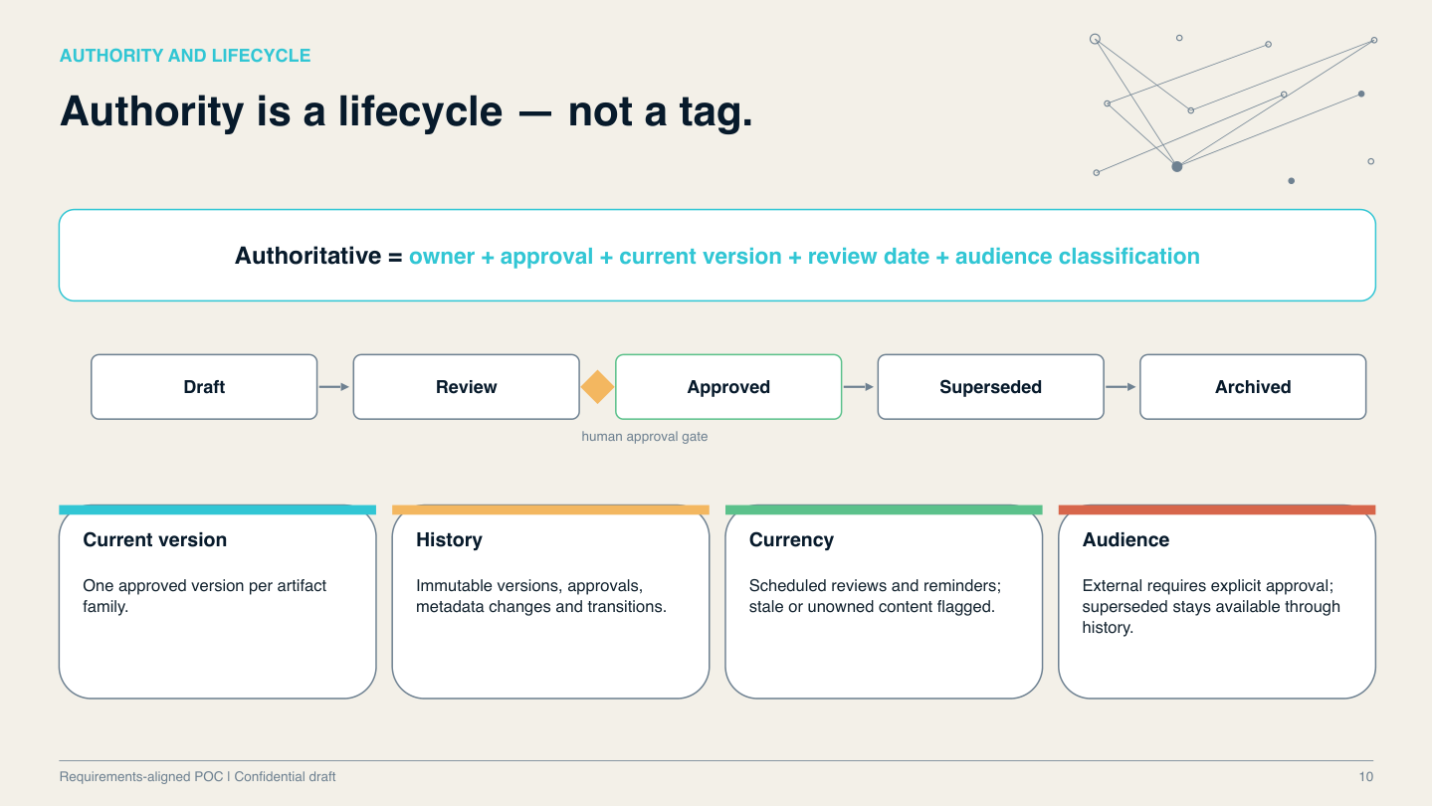

Slide 11
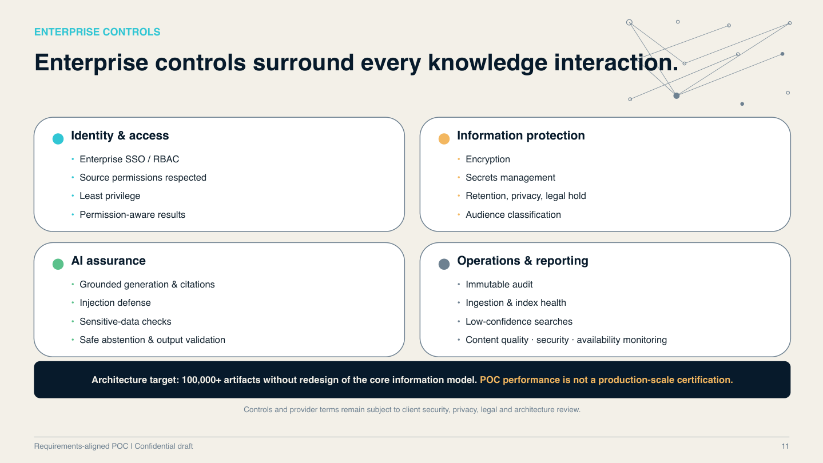

Slide 12
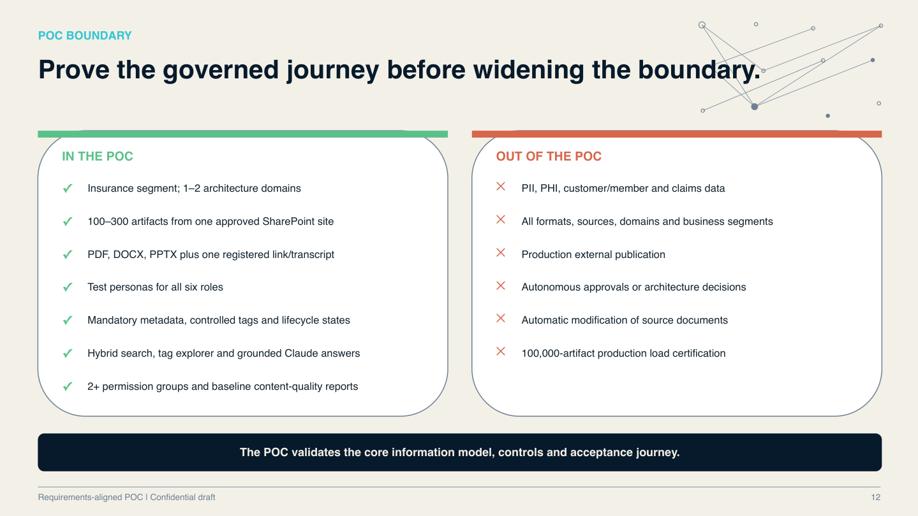

Slide 13
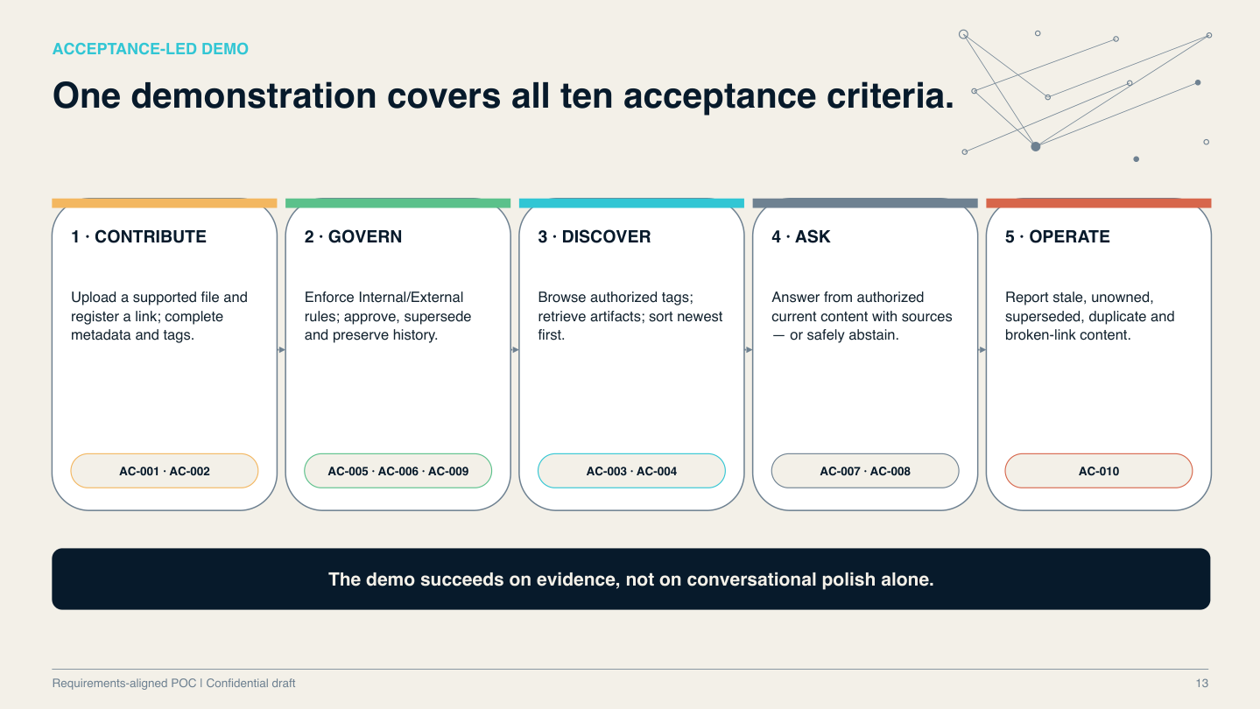

Slide 14
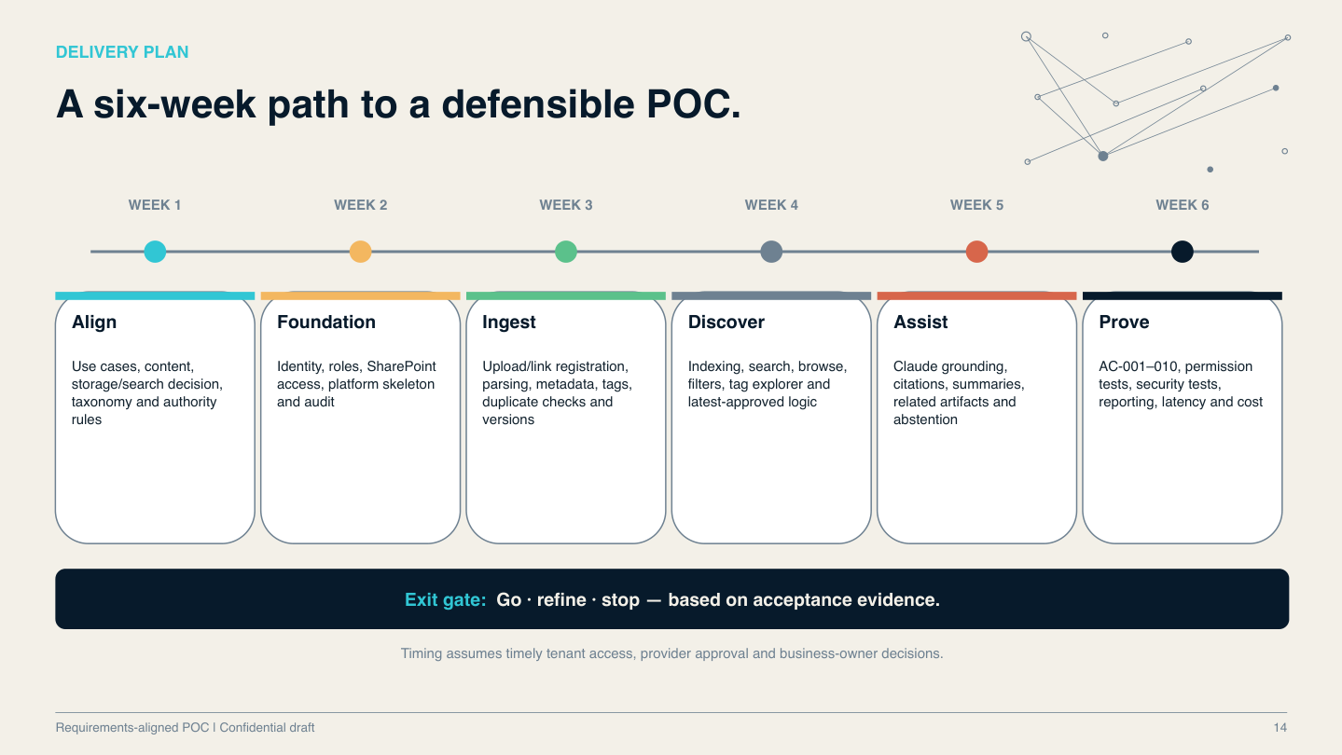

Slide 15
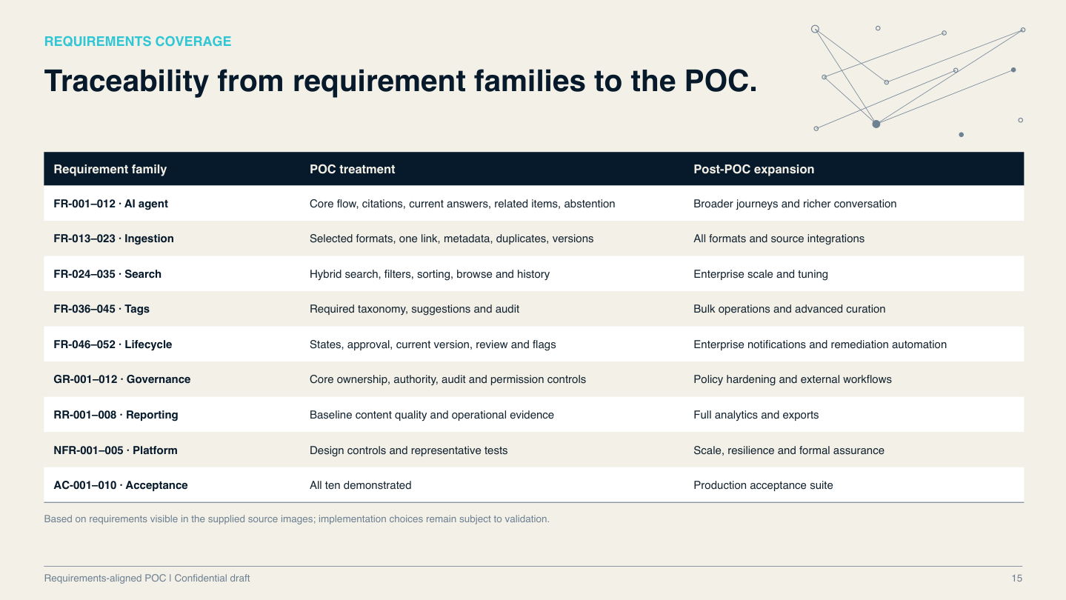

Slide 16
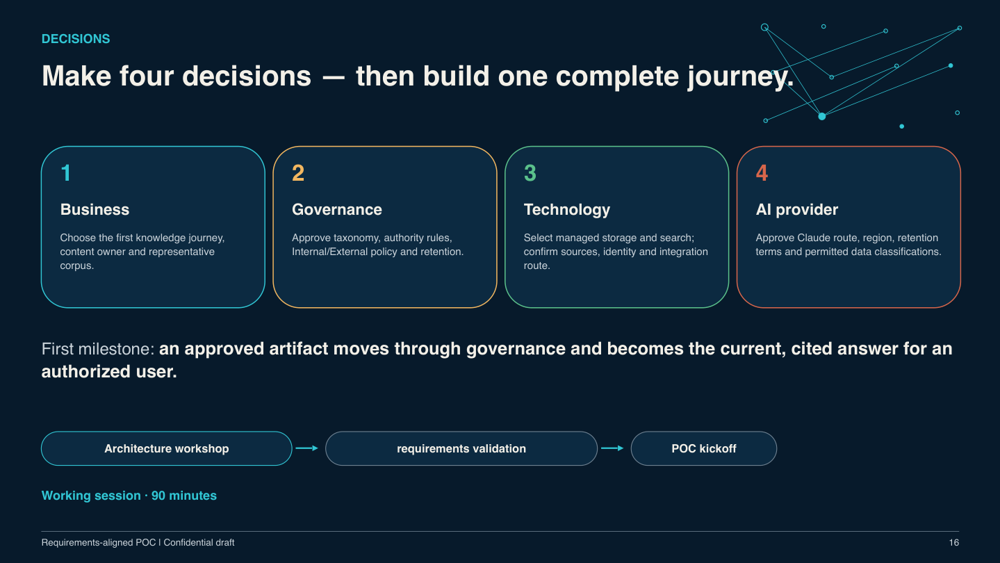

Slide 17
ARCHITECTURE OPTION 1
Microsoft 365 Copilot Declarative Agent
Solution design
Best-fit scenario
Declarative agent grounded in approved SharePoint sources inside the M365 Copilot experience.
Fast discovery pilot and secondary user channel.
Advantages
Trade-offs / controls
Planning assumptions
Rapid configuration; native M365 user experience; platform-managed permissions.
Limited control of ranking, approval logic and custom repository workflows; validate licensing and model route.
Indicative delivery: 2–5 weeks
Indicative build cost: $15K–$50K
Costs exclude ongoing licenses, cloud usage, data preparation and client approvals.
All estimates are illustrative planning ranges; validate with vendors and staffing assumptions.
Requirements-aligned POC | Architecture options | Confidential draft
17

Slide 18
ARCHITECTURE OPTION 2
Microsoft Copilot Studio
Solution design
Best-fit scenario
Low-code agent with SharePoint grounding, Topics, connectors and Power Platform workflows.
Workflow-led assistant in a Power Platform estate.
Advantages
Trade-offs / controls
Planning assumptions
Strong Teams integration; business-managed dialog flows; low-code orchestration.
Governance logic may span Studio, Dataverse and Power Automate; Claude requires integration.
Indicative delivery: 4–10 weeks
Indicative build cost: $35K–$120K
Costs exclude ongoing licenses, cloud usage, data preparation and client approvals.
All estimates are illustrative planning ranges; validate with vendors and staffing assumptions.
Requirements-aligned POC | Architecture options | Confidential draft
18

Slide 19
ARCHITECTURE OPTION 3
Live Microsoft Graph Search + Claude
Solution design
Best-fit scenario
Search SharePoint at request time using delegated Graph access; send permitted evidence to Claude.
Low-infrastructure technical spike or reference baseline.
Advantages
Trade-offs / controls
Planning assumptions
Zero-copy retrieval; current source content; user-context permissions.
Graph latency; semantic relevance and current-approved filtering require additional design.
Indicative delivery: 4–8 weeks
Indicative build cost: $40K–$110K
Costs exclude ongoing licenses, cloud usage, data preparation and client approvals.
All estimates are illustrative planning ranges; validate with vendors and staffing assumptions.
Requirements-aligned POC | Architecture options | Confidential draft
19

Slide 20
ARCHITECTURE OPTION 4
Graph + Azure AI Search + Claude
Solution design
Best-fit scenario
Graph sync and ACL propagation to a hybrid search index; governed retrieval before Claude synthesis.
Leading governed production architecture candidate.
Advantages
Trade-offs / controls
Planning assumptions
Keyword/vector/semantic search; structured filters; controllable ranking and citations.
Engineering for ingestion, permission changes, deletion, version authority and index freshness.
Indicative delivery: 10–20 weeks
Indicative build cost: $130K–$350K
Costs exclude ongoing licenses, cloud usage, data preparation and client approvals.
All estimates are illustrative planning ranges; validate with vendors and staffing assumptions.
Requirements-aligned POC | Architecture options | Confidential draft
20

Slide 21
ARCHITECTURE OPTION 5
Graph + Alternative Enterprise Search
Solution design
Best-fit scenario
Graph ingestion and security synchronization into an existing or new search/vector engine.
Alternative when enterprise standards mandate another engine.
Advantages
Trade-offs / controls
Planning assumptions
Vendor flexibility; reuse existing search investments; model independence.
Custom ACL adapter, relevance tuning, vendor integration and operations burden.
Indicative delivery: 10–22 weeks
Indicative build cost: $120K–$340K
Costs exclude ongoing licenses, cloud usage, data preparation and client approvals.
All estimates are illustrative planning ranges; validate with vendors and staffing assumptions.
Requirements-aligned POC | Architecture options | Confidential draft
21

Slide 22
ARCHITECTURE OPTION 6
Graph + Next.js + Claude (Zero-Copy)
Solution design
Best-fit scenario
Next.js server routes query Graph and compose Claude prompts from live authorized documents.
Developer-led prototype; not sufficient alone for full governance.
Advantages
Trade-offs / controls
Planning assumptions
Simple UI/API stack; no vector store; low data duplication.
Metadata filters, approval/version selection and deep semantic ranking remain difficult.
Indicative delivery: 4–8 weeks
Indicative build cost: $40K–$110K
Costs exclude ongoing licenses, cloud usage, data preparation and client approvals.
All estimates are illustrative planning ranges; validate with vendors and staffing assumptions.
Requirements-aligned POC | Architecture options | Confidential draft
22

Slide 23
ARCHITECTURE OPTION 7
Azure Search + Cosmos DB + Next.js + Claude
Solution design
Best-fit scenario
Blob document storage, Cosmos governance ledger, Azure AI Search retrieval, Next.js UI/API.
Enterprise production design with strong Azure alignment.
Advantages
Trade-offs / controls
Planning assumptions
Separation of content authority and index; strict metadata filters; managed search.
Multiple data services; sync jobs and access-policy enforcement must be engineered and tested.
Indicative delivery: 12–24 weeks
Indicative build cost: $150K–$400K
Costs exclude ongoing licenses, cloud usage, data preparation and client approvals.
All estimates are illustrative planning ranges; validate with vendors and staffing assumptions.
Requirements-aligned POC | Architecture options | Confidential draft
23

Slide 24
ARCHITECTURE OPTION 8
PostgreSQL pgvector + Prisma + Next.js
Solution design
Best-fit scenario
Single PostgreSQL platform for governance metadata, versions and vectors; Next.js orchestration.
Lean team or cost-conscious governed MVP.
Advantages
Trade-offs / controls
Planning assumptions
Developer velocity; relational lifecycle model; fewer managed services.
Custom hybrid ranking, RLS, scaling, indexing and operational assurance required.
Indicative delivery: 8–16 weeks
Indicative build cost: $75K–$220K
Costs exclude ongoing licenses, cloud usage, data preparation and client approvals.
All estimates are illustrative planning ranges; validate with vendors and staffing assumptions.
Requirements-aligned POC | Architecture options | Confidential draft
24

Slide 25
ARCHITECTURE OPTION 9
AWS Bedrock Knowledge Bases + Claude
Solution design
Best-fit scenario
S3 ingestion to Bedrock Knowledge Bases; Next.js frontend and Claude inference through Bedrock.
Organizations standardized on AWS.
Advantages
Trade-offs / controls
Planning assumptions
Managed ingestion and embedding; AWS-native model integration.
Lifecycle authority and SharePoint ACL synchronization require custom controls; AWS boundary.
Indicative delivery: 10–20 weeks
Indicative build cost: $110K–$300K
Costs exclude ongoing licenses, cloud usage, data preparation and client approvals.
All estimates are illustrative planning ranges; validate with vendors and staffing assumptions.
Requirements-aligned POC | Architecture options | Confidential draft
25

Slide 26
ARCHITECTURE OPTION 10
Commercial AI Search (Glean / Coveo)
Solution design
Best-fit scenario
Commercial enterprise connectors and search services, optionally exposed in custom Next.js UI.
Buy-over-build strategy for broad enterprise discovery.
Advantages
Trade-offs / controls
Planning assumptions
Fast connector rollout; managed search and security trimming; smaller custom retrieval layer.
Recurring license costs; limited custom approval workflow control; vendor dependence.
Indicative delivery: 6–14 weeks
Indicative build cost: $60K–$200K + licenses
Costs exclude ongoing licenses, cloud usage, data preparation and client approvals.
All estimates are illustrative planning ranges; validate with vendors and staffing assumptions.
Requirements-aligned POC | Architecture options | Confidential draft
26

Slide 27
EXECUTIVE FRAMING
Retain ten approaches. Prioritize a lean Azure architecture.
New preferred candidate: Azure AI Search + Next.js + Claude, with Graph and SharePoint governance explicitly included.
LANDSCAPE
PREFERRED POC
EXPANSION PATH
Options 1–10 remain in the deck for auditability and alternatives.
The first 16 slides preserve the requirements-led POC proposal.
Graph + SharePoint + Azure AI Search + Next.js + Claude.
No Cosmos DB in the initial POC if SharePoint can remain the governance system of record.
Add Cosmos DB only when requirements justify a separate transactional governance store.
Decision based on tested workflow and audit gaps.
Requirements-aligned POC | Executive architecture review | Confidential draft
27

Slide 28
ARCHITECTURE DECISION
Three closely related Microsoft-centered designs
Azure AI Search and Claude are common. The key decision is where authoritative governance data lives.
A · GRAPH + SEARCH + CLAUDE
B · SEARCH + NEXT.JS + CLAUDE
C · SEARCH + COSMOS + NEXT.JS + CLAUDE
Reference pattern.
Graph syncs SharePoint; search retrieves evidence; Claude synthesizes.
UI and governance implementation still need specification.
Preferred lean application design.
Next.js provides UX and APIs; Graph connects SharePoint; SharePoint holds authoritative approvals and versions.
Extended enterprise design.
Cosmos stores custom metadata, relationships and lifecycle transactions; higher build and operational burden.
Requirements-aligned POC | Executive architecture review | Confidential draft
28

Slide 29
PREFERRED ARCHITECTURE
End-to-end design and trust boundaries
Authorization and latest-approved filtering must occur before content is sent to Claude.
1 IDENTITY & UI
2 GOVERNED CONTENT
3 RETRIEVAL
4 GENERATION & AUDIT
Entra ID SSO → Next.js UI / server APIs
Role-specific chat, browse, contribute, approve
SharePoint documents, lists, metadata, versions and approvals
Microsoft Graph delta sync + ACL changes
Background workers → chunking / embeddings → Azure AI Search
Hard ACL, audience, status and current-version filters
Minimum authorized evidence → Claude API → citation validation
Logs, monitoring, safe abstention and source links
Requirements-aligned POC | Executive architecture review | Confidential draft
29

Slide 30
DESIGN PRINCIPLES
Removing Cosmos DB does not remove governance
Azure AI Search is a retrieval index—not the system of record for approvals, ownership or immutable audit.
SYSTEM OF RECORD
INDEX PROJECTION
APPLICATION LAYER
SharePoint files and governed lists hold source content, lifecycle state, current version, owner, review date and audience.
Confirm whether native audit and retention satisfy policy.
Azure AI Search holds chunks, embeddings, searchable tags, approved/current flags and ACL identifiers.
Rebuildable; synchronize deletion and permission revocation.
Next.js handles contribution, role-aware experiences, approval requests, citations and reports.
Long-running ingestion belongs in background workers, not web requests.
Requirements-aligned POC | Executive architecture review | Confidential draft
30

Slide 31
GOVERNANCE MAPPING
Where each POC requirement will live
Six roles and the five-state lifecycle remain unchanged from the original requirements.
SHAREPOINT
NEXT.JS + WORKERS
AZURE SEARCH + CLAUDE
Documents and registered links
Owner, review date, taxonomy and status
Version history and approved artifact family
Approval and retention controls
Role-aware UI and validation
Contribution / review flows
Sync jobs, duplicate checks
Audit events and health dashboards
Hybrid retrieval and tag filters
Permission-aware evidence selection
Latest-approved prioritization
Cited responses and abstention
Requirements-aligned POC | Executive architecture review | Confidential draft
31

Slide 32
IMPLEMENTATION ESTIMATE
Six-week POC: scope and effort
Illustrative labor-only budget. Assumes 100–300 artifacts, one SharePoint site, prompt tenant access and no regulated data.
WEEKS 1–2 | $13K–$25K
WEEKS 3–4 | $16K–$30K
WEEKS 5–6 | $15K–$27K
Design, taxonomy, role mapping, security decisions.
Next.js foundation, Entra ID and Graph connectivity.
Metadata and ingestion, lifecycle logic, index construction, hybrid search and filters.
Test deletions and ACL changes.
Claude grounding, citations, reporting, test personas, ten acceptance tests and VP demo.
TOTAL: $44K–$82K labor.
Requirements-aligned POC | Executive architecture review | Confidential draft
32

Slide 33
COSTS AND TCO
Budget beyond the proof of concept
No vendor quote is implied; actual costs depend on Azure region, search tier, token usage, users, storage and enterprise agreements.
ONE-TIME COSTS
RECURRING COSTS
THREE-YEAR TCO
Architecture / UX design
Application and ingestion development
Security and compliance review
Data cleanup and taxonomy
Testing and rollout
Azure AI Search capacity
Next.js hosting and background compute
Claude inference / embedding model
Logging, monitoring, backups
Support, licensing and operations
TCO = build + migration + 36 months run + support + contingency.
Compare low / base / high usage scenarios.
Separate vendor charges from labor.
Requirements-aligned POC | Executive architecture review | Confidential draft
33

Slide 34
SECURITY ASSURANCE
Controls that cannot be deferred
The platform must never rely on a Claude prompt to enforce authorization or lifecycle authority.
IDENTITY & PERMISSIONS
DATA & AI
OPERATIONS
Entra ID / least privilege
SharePoint ACL sync
User/group security trimming
Revocation and deletion tests
Approved Claude route and region
Data retention and classification review
Prompt-injection resistance
Sensitive-data checks / citations
Audit trail and access logs
Index drift and sync monitoring
Incident response / rollback
Safe abstention on weak evidence
Requirements-aligned POC | Executive architecture review | Confidential draft
34

Slide 35
TRADE-OFF ANALYSIS
Lean design versus dedicated Cosmos governance
Cosmos DB is a conditional extension, not a prerequisite for production-grade retrieval.
LEAN: SHAREPOINT GOVERNANCE
EXTENDED: COSMOS GOVERNANCE
DECISION TRIGGERS
Advantages: fewer services, faster POC, native document history, simpler integration.
Risks: complex cross-artifact relationships, transaction workflows and reporting may become cumbersome.
Advantages: custom data model, explicit transaction workflows, complex relationships and reporting.
Risks: dual-system consistency, added operations, migration and security boundaries.
Add Cosmos if SharePoint cannot meet tested requirements for approval transactions, relationship graph, reporting, performance or audit retention.
Document evidence before expansion.
Requirements-aligned POC | Executive architecture review | Confidential draft
35

Slide 36
OPTION SCORECARD
How the VP should compare all ten approaches
Use a weighted decision matrix against the same corpus and acceptance tests—not an unverified vendor ranking.
WEIGHTED CRITERIA
CANDIDATE FOCUS
EVIDENCE TO COLLECT
Governance and latest-approved: 25%
Security / permission accuracy: 25%
Retrieval and citation quality: 20%
Cost / operations: 15%
Time to deliver: 10%
Portability: 5%
Option 4: Graph + Azure Search + Claude
Option 7: Search + Cosmos + Next.js + Claude
New lean variant: Search + Next.js + Claude, with Graph / SharePoint.
10 acceptance criteria
Permission and revocation tests
Citation precision and abstention
Latency and ingestion lag
Monthly cost per usage scenario
Requirements-aligned POC | Executive architecture review | Confidential draft
36

Slide 37
PRODUCTION READINESS
POC success is not production certification
The original 100,000+ artifact target remains a future scale requirement.
POC EXIT GATES
PRODUCTION HARDENING
EXPANSION
Demonstrate AC-001–010
Correct latest-approved selection
Zero unauthorized evidence exposure in test suite
Source-openable citations
Business-owner signoff
HA / DR, SLOs and incident runbooks
Scale and load testing
Operational cost alerts
Index rebuild and reconciliation
Privacy / legal approval
Additional formats and sites
Multiple domains and segments
Broader governance workflows
Formal retention and external publishing
Optional Cosmos decision
Requirements-aligned POC | Executive architecture review | Confidential draft
37

Slide 38
EXECUTIVE DECISION
Approve one lean POC, preserve the expansion option
The company is selecting a testable architecture direction—not committing to a final production product.
REQUEST 1 · SCOPE
REQUEST 2 · DESIGN
REQUEST 3 · GATE
Approve Insurance pilot: 100–300 artifacts, six roles, 2+ permission groups, PDF/DOCX/PPTX and one registered link.
Authorize Next.js + Graph + SharePoint governance + Azure AI Search + Claude as the preferred POC baseline.
Keep Cosmos as an explicit option.
Approve a six-week acceptance-led evaluation, subject to access and security approvals.
At exit: GO / REFINE / STOP based on evidence.
Requirements-aligned POC | Executive architecture review | Confidential draft
38

